Slide 1



MEAN Stack – Section 02
Mark J. Buckler
OCPJP,CIWJS

Slide 2

Credits
Some of the contents of this slide presentation have been referenced and reproduced, from MEAN Stack and MongoDB: Development Techniques, by Alexander Zanfir, ©2018 LinkedIn Corporation.

Slide 3
LEARNING OBJECTIVES
Create a Query with MongoDB
Create an Endpoint with ExpressJS
Create a View in AngularJS

Slide 4
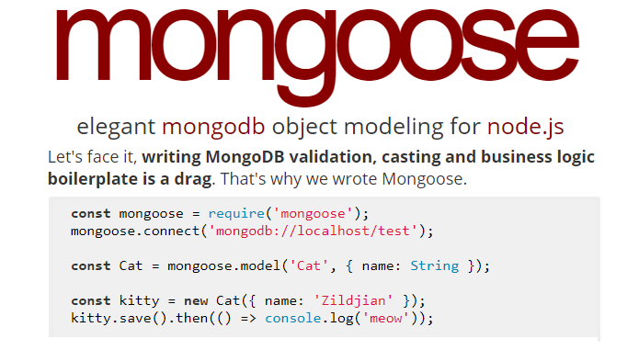
Create a Query with MongoDB
Mongoose
A third-party MongoDB package built on top of the official driver: http://mongoosejs.com/
Its strength and purpose is modeling data

Slide 5
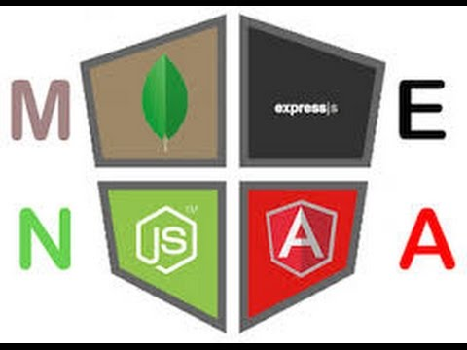
Create a Query with MongoDB
Programming Exercise06_02_01 – Step 1
Create a Message List Query with MongoDB

Slide 6
Create a Query with MongoDB
Programming Exercise06_02_01 – Step 2
Create a Message List Endpoint with ExpressJS

Slide 7
Create a Query with MongoDB
Programming Exercise06_02_01 – Step 3
Create a Message List View in AngularJS

